Slide 1


Azərbaycan Dövlət Neft və Sənaye Universiteti
Calculus
Single Variable

Slide 2
Application of Differentiation: Summary of Curve Sketching

Slide 3
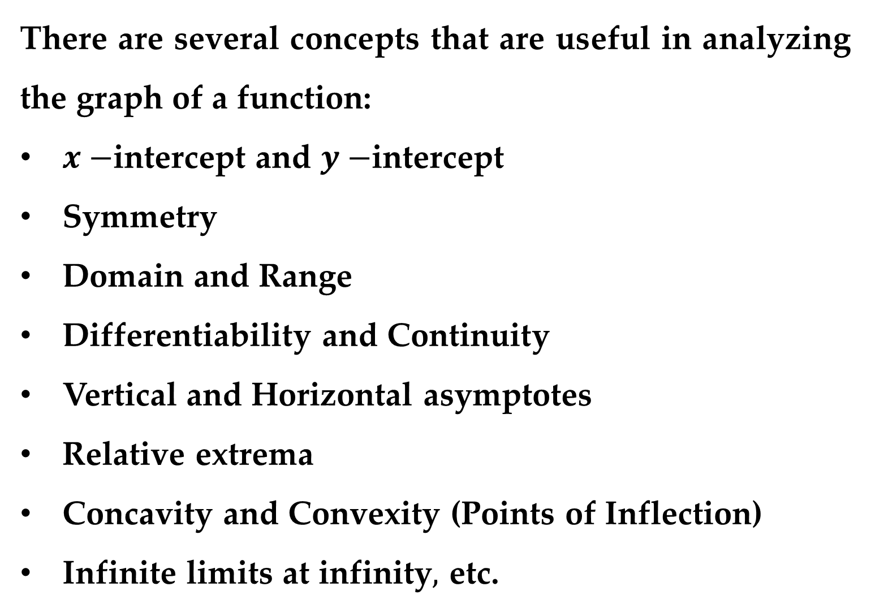
There are several concepts that are useful in analyzing the graph of a function:
$x−$intercept and $y−$intercept
Symmetry
Domain and Range
Differentiability and Continuity
Vertical and Horizontal asymptotes
Relative extrema
Concavity and Convexity (Points of Inflection)
Infinite limits at infinity$,$ etc.

Slide 4
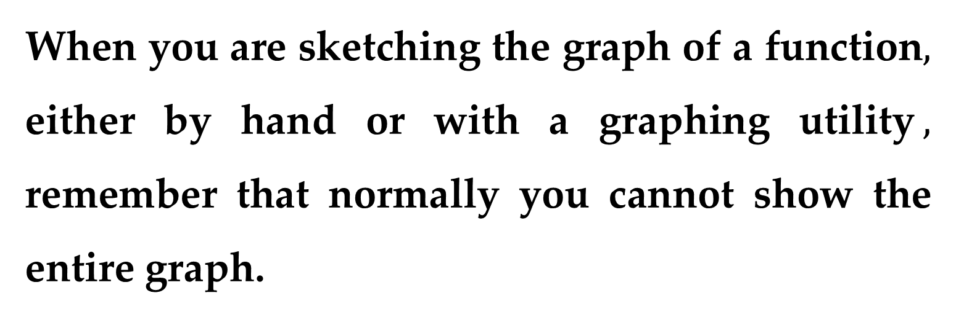
When you are sketching the graph of a function$,$ either by hand or with a graphing utility$,$ remember that normally you cannot show the entire graph.
The decision as to which part of the graph you choose to show is often crucial.

Slide 5
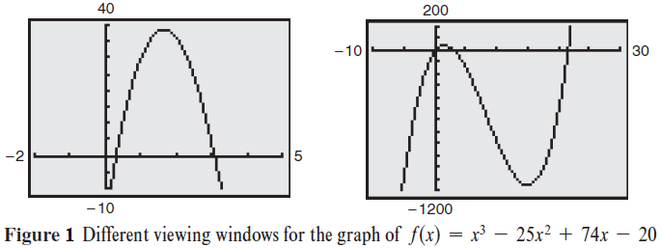
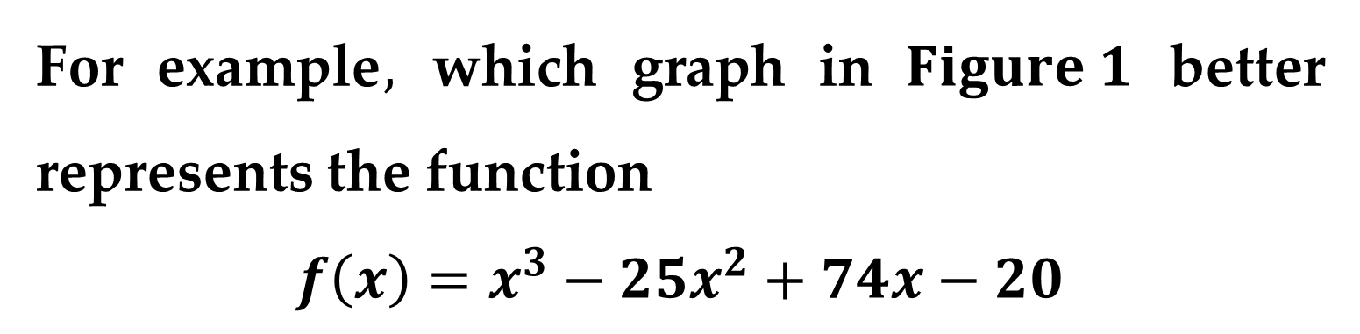
For example$,$ which graph in $Figure 1$ better represents the function
$$f\left(x\right)=x^{3}−25x^{2}+74x−20$$

Slide 6
It is clear that the second graph (on the right) gives a more complete representation of the graph.
Question
But would a third viewing window reveal other interesting portions of the graph?

Slide 7
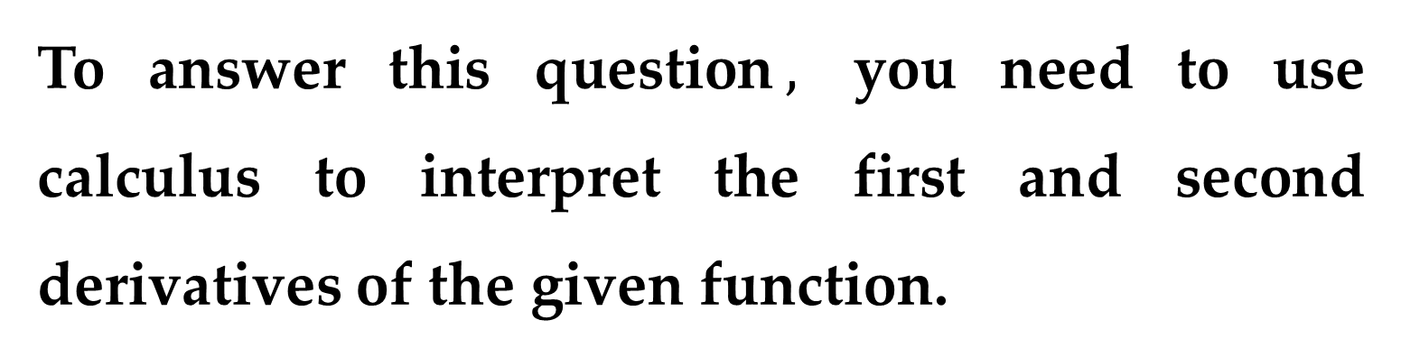
To answer this question$,$ you need to use calculus to interpret the first and second derivatives of the given function.
Here are some guidelines for determining a good viewing window for the graph of a function (guidelines for analyzing the graph of a function).

Slide 8
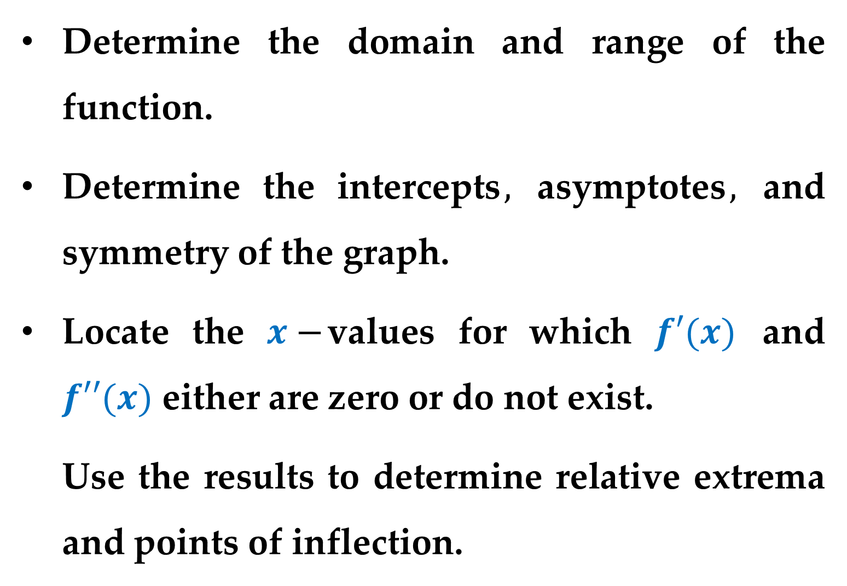
Determine the domain and range of the function.
Determine the intercepts$,$ asymptotes$,$ and symmetry of the graph.
Locate the $x−$values for which $f′(x)$ and $f′′(x)$ either are zero or do not exist.
Use the results to determine relative extrema and points of inflection.

Slide 9
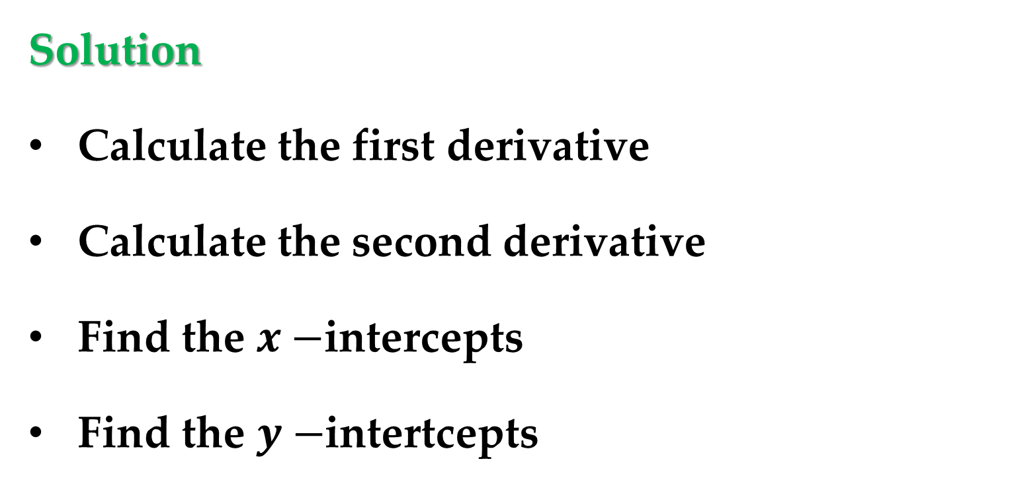

Example 1. Sketching the Graph of a Function
Analyze and sketch the graph of
$$f\left(x\right)=\frac{2(x^{2}−9)}{x^{2}−4}$$
Solution
Calculate the first derivative
Calculate the second derivative
Find the $x−$intercepts
Find the $y−$intertcepts

Slide 10
Solution (continued)
Find the vertical and horizontal asymptotes
Find the critical numbers
Find the possible points of inflection
Test for symmetry
Find the domain and range of the function

Slide 11
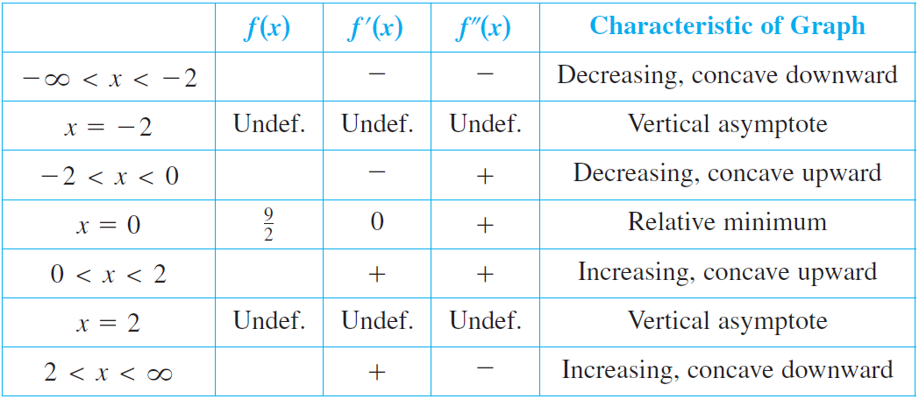
Solution (continued)
The table below shows how the test intervals are used to determine several characteristics of the graph.

Slide 12
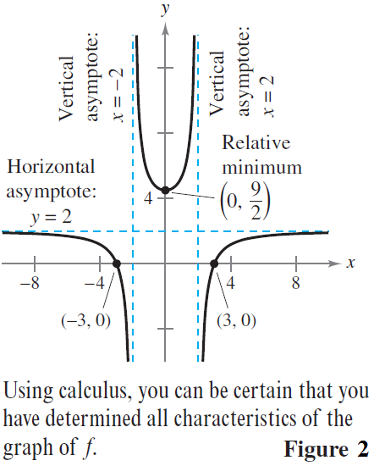
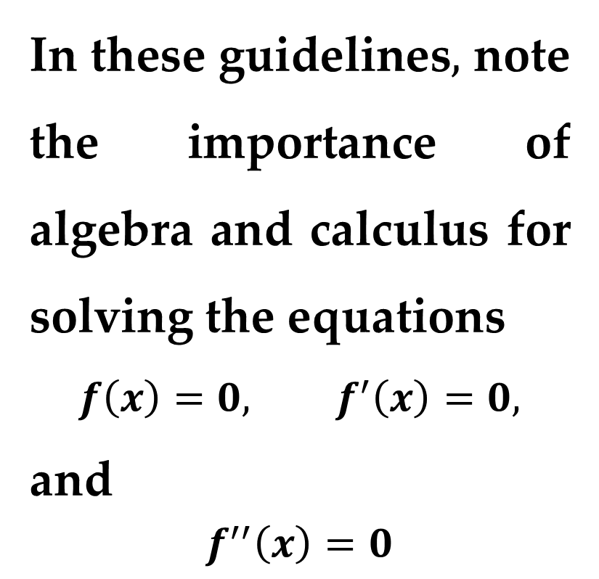
Solution (continued)
The graph of $f(x)$ is shown in $Figure 2$.
In these guidelines$,$ note the importance of algebra and calculus for solving the equations
$$f\left(x\right)=0, f^{′}\left(x\right)=0,$$
and
$$f^{′′}\left(x\right)=0$$

Slide 13

Example 2. Sketching the Graph of a Function
Analyze and sketch the graph of
$$f\left(x\right)=\frac{x^{2}−2x+4}{x−2}$$
Solution
Calculate the first derivative
Calculate the second derivative
Find the $x−$intercepts
Find the $y−$intertcepts

Slide 14
Solution (continued)
Find the vertical and horizontal asymptotes
Find the critical numbers
Find the possible points of inflection
Test for symmetry
Find the domain and range of the function

Slide 15
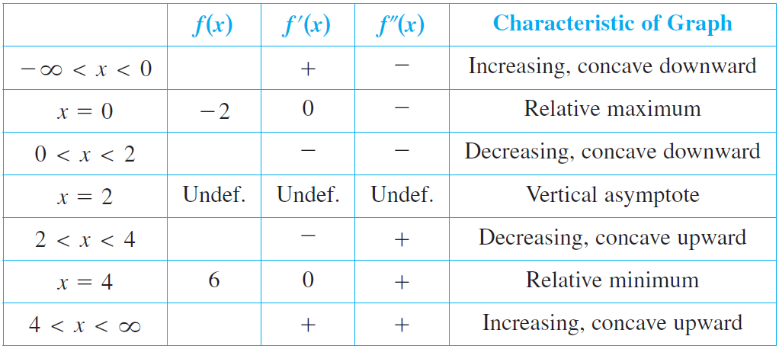
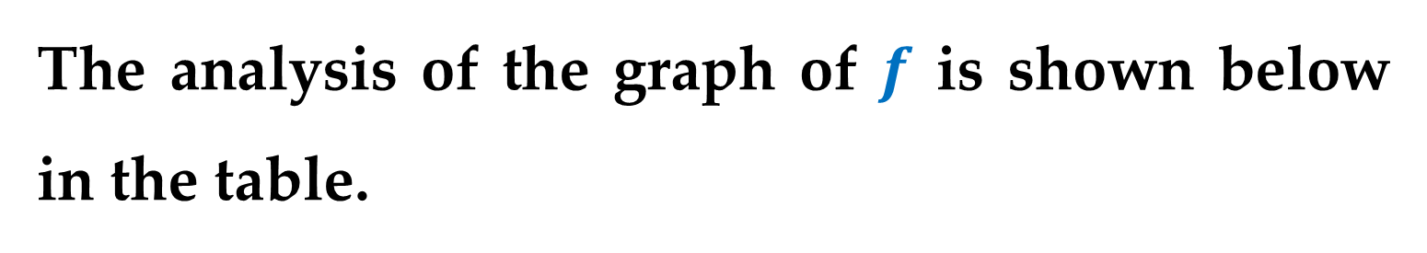
Solution (continued)
The analysis of the graph of $f$ is shown below in the table.

Slide 16
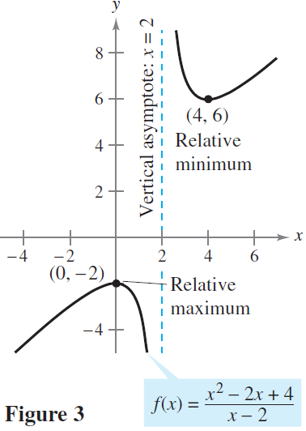
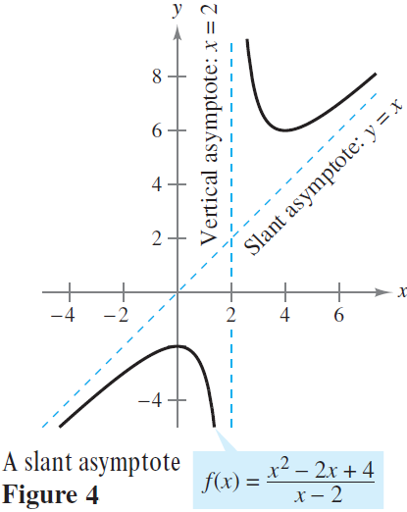

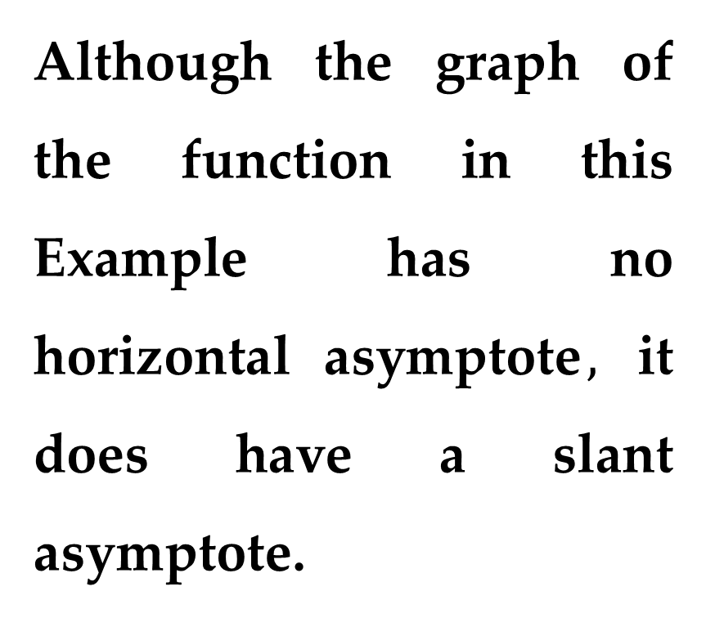
Solution (continued)
The graph of $f$ is shown in $Figure 3$.
Although the graph of the function in this Example has no horizontal asymptote$,$ it does have a slant asymptote.

Slide 17
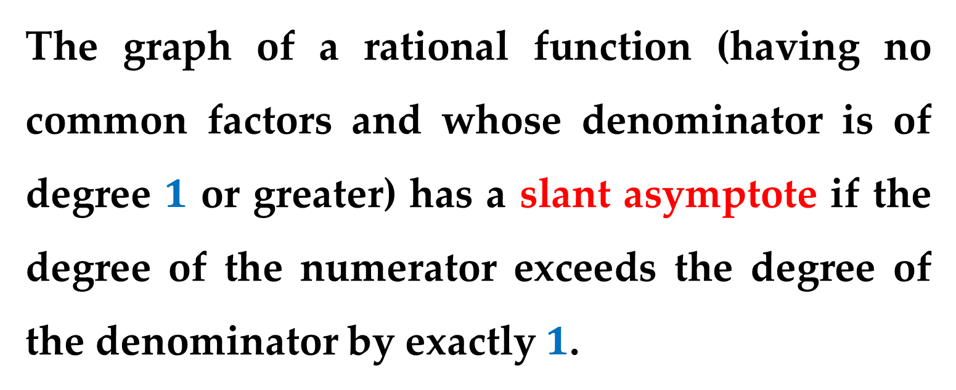
Remark
The graph of a rational function (having no common factors and whose denominator is of degree $1$ or greater) has a slant asymptote if the degree of the numerator exceeds the degree of the denominator by exactly $1$.

Slide 18
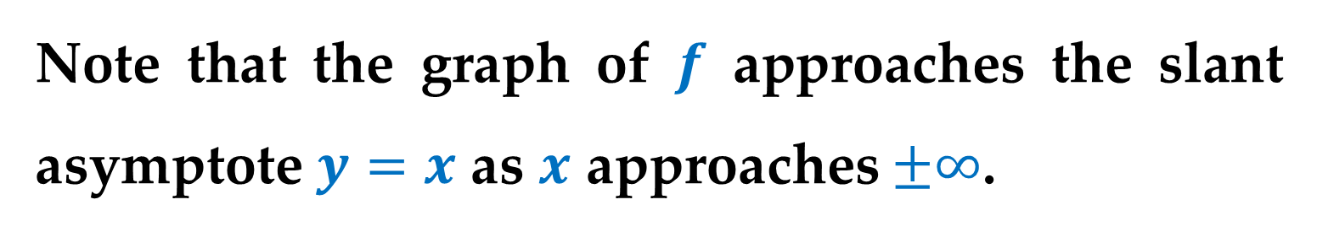
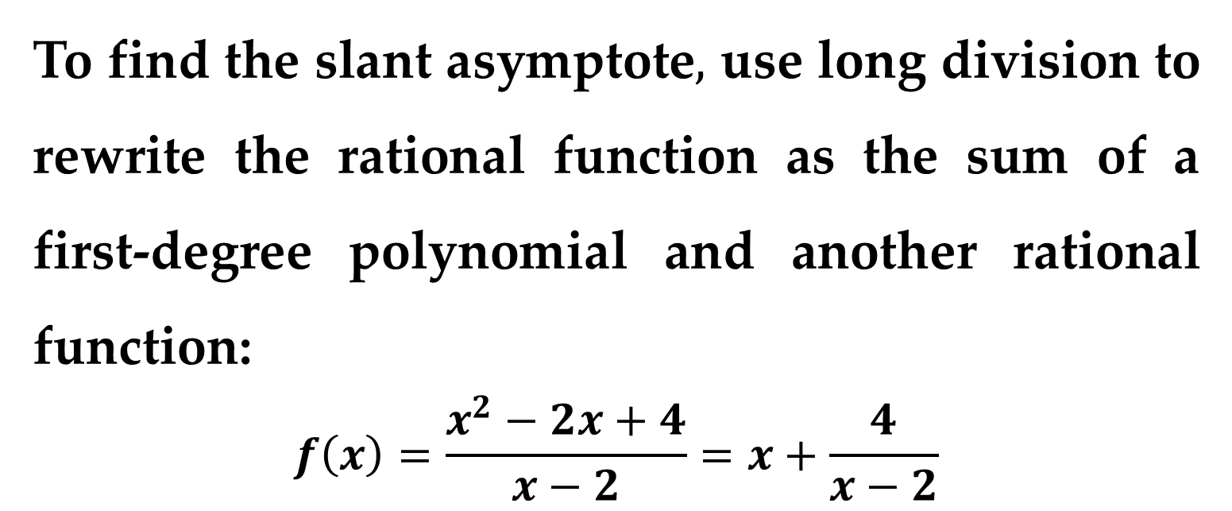
To find the slant asymptote$,$ use long division to rewrite the rational function as the sum of a first-degree polynomial and another rational function:
$$f\left(x\right)=\frac{x^{2}−2x+4}{x−2}=x+\frac{4}{x−2}$$
Note that the graph of $f$ approaches the slant asymptote $y=x$ as $x$ approaches $±∞$.

Slide 19

Example 3. Sketching the Graph of a Function
Analyze and sketch the graph of
$$f\left(x\right)=\frac{x}{\sqrt{x^{2}+2}}$$
Solution
Calculate the first derivative
Calculate the second derivative
Find the $x−$intercepts
Find the $y−$intertcepts

Slide 20
Solution (continued)
Find the vertical and horizontal asymptotes
Find the critical numbers
Find the possible points of inflection
Test for symmetry
Find the domain and range of the function

Slide 21
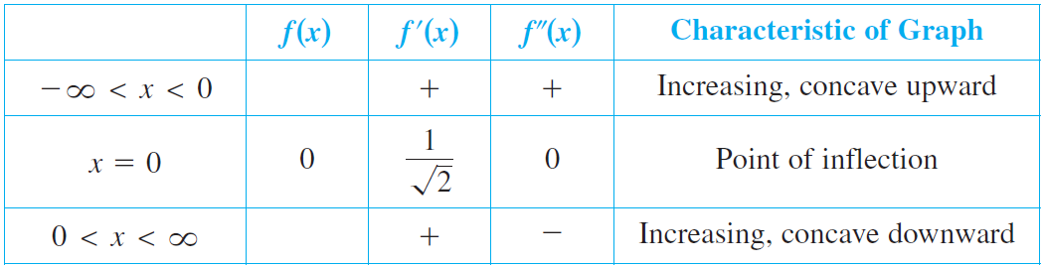
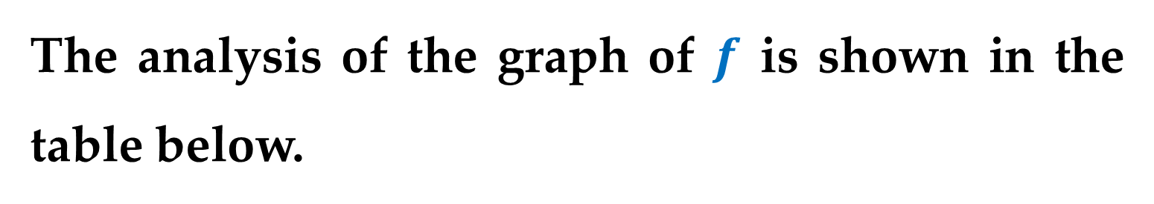
Solution (continued)
The analysis of the graph of $f$ is shown in the table below.

Slide 22
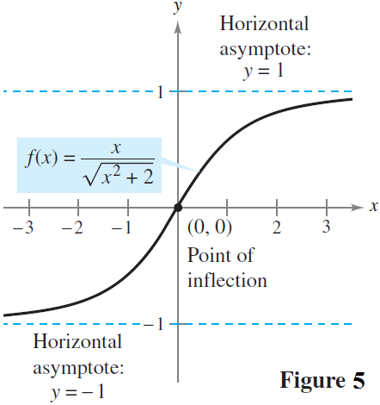
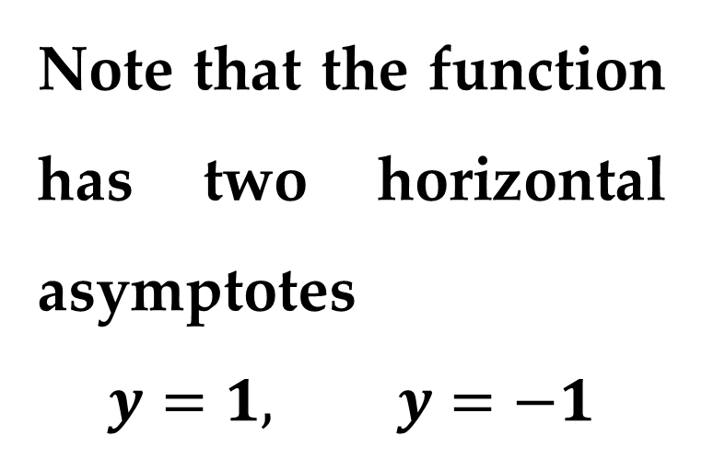
Solution (continued)
The graph of $f$ is shown in $Figure 5$.
Note that the function has two horizontal asymptotes
$$y=1, y=−1$$

Slide 23

Example 4. Sketching the Graph of a Radical
Function
Analyze and sketch the graph of
$$f\left(x\right)=2x^{5/3}−5x^{4/3}$$
Solution
Calculate the first derivative
Calculate the second derivative
Find the $x−$intercepts
Find the $y−$intertcepts

Slide 24
Solution (continued)
Find the vertical and horizontal asymptotes
Find the critical numbers
Find the possible points of inflection
Test for symmetry
Find the domain and range of the function

Slide 25
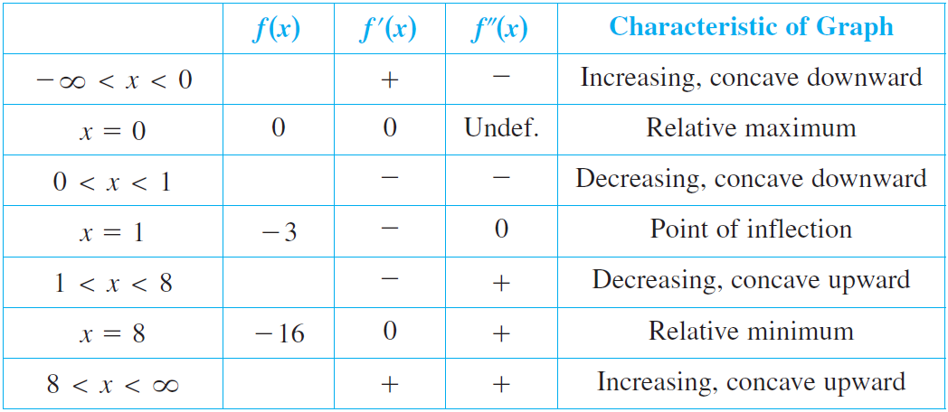
Solution (continued)
The analysis of the graph of $f$ is shown in the table below.

Slide 26
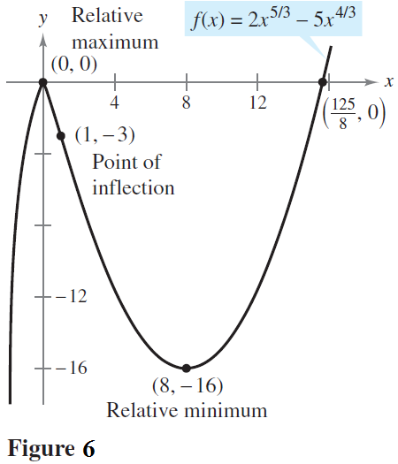

Solution (continued)
The graph of $f$ is shown in $Figure 6$.

Slide 27

Example 5. Sketching the Graph of a
Polynomial Function
Analyze and sketch the graph of
$$f\left(x\right)=x^{4}−12x^{3}+48x^{2}−64x$$
Solution
Calculate the first derivative
Calculate the second derivative
Find the $x−$intercepts
Find the $y−$intertcepts

Slide 28
Solution (continued)
Find the vertical and horizontal asymptotes
Find the critical numbers
Find the possible points of inflection
Test for symmetry
Find the domain and range of the function

Slide 29
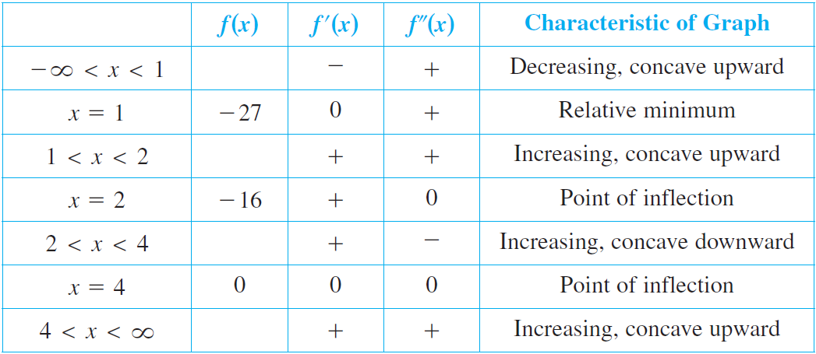

Solution (continued)
The analysis of the graph of $f$ is shown in the table below.

Slide 30
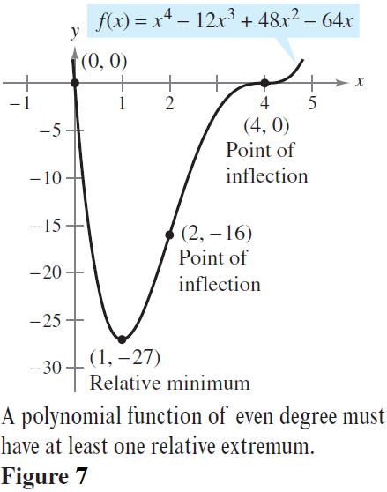

Solution (continued)
The graph of $f$ is shown in $Figure 7$.

Slide 31

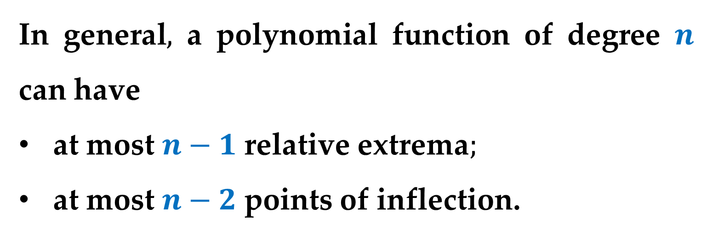
Remark
In general$,$ a polynomial function of degree $n$ can have
at most $n−1$ relative extrema$;$
at most $n−2$ points of inflection.
Moreover$,$ polynomial functions of even degree must have at least one relative extremum.

Slide 32

Example 6. Sketching the Graph of a
Trigonometric Function
Analyze and sketch the graph of
$$f\left(x\right)=\frac{\cos{x}}{1+\sin{x}}$$
Solution
Calculate the first derivative
Calculate the second derivative
Find the $x−$intercepts
Find the $y−$intertcepts

Slide 33
Solution (continued)
Find the vertical and horizontal asymptotes
Find the critical numbers
Find the possible points of inflection
Test for symmetry
Find the domain and range of the function

Slide 34
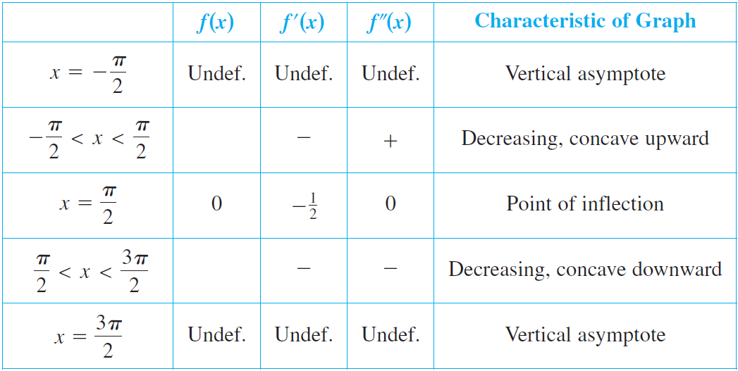
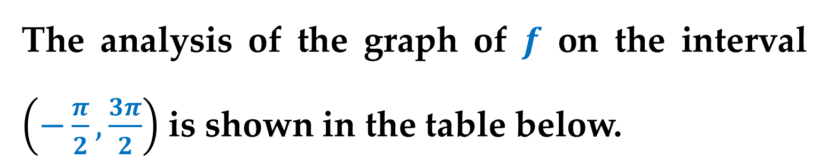
Solution (continued)
The analysis of the graph of $f$ on the interval $\left(−\frac{π}{2},\frac{3π}{2}\right)$ is shown in the table below.

Slide 35
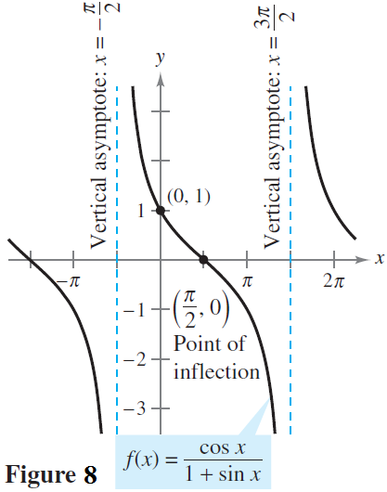

Solution (continued)
The graph of $f$ is shown in $Figure 8$.

Slide 36
Thank you for attention

